Slide 1
MAM01 – Workshop: Application Cloud Modernization and Migration
Monday Dec. 3rd
Session 03

Slide 2
DevOps
This is not optional!

Slide 3
DevOps is table stakes
In order to successfully migration and/or modernize teams need to improve their DevOps
DevOps is any process, procedure, or tool that reduces the impedance from idea to production software.
Team w/o DevOps lack the ability for sustained engineering e.g. the can't manage either RISK or TEMPO

Slide 4
Key Ideas
Idea 1: Have a build pipeline to gain momentum, and enforce standards and process. e.g. Build ONCE, deploy and test MANY TIMES
Idea 2: Pull streams of data (logs, events, state) into tools, filter and decide what's an incident, then manage them centrally, notifying who/what needs to be notified. Note that in many cases, this can evolve toward self-healing.
Idea 3: If what comes out of the hosting environment is not useful, fix the code and system until it is. This is a journey not a destination.
Idea 4: Drive to self-healing. Auto-scaling, fail-over/fail-back, re-paving, broken-tooth-replacement, auto-provisioning, etc. can help organizations own apps where touch by humans is increasingly rare.
Idea 5: Don't eat the whole elephant at once: crawl, walk, fly. Adopt #1 and #2, and then follow the pain. Savings are sure to follow.

Slide 5
Goals and non-Goals
Goal: TEMPO the ability to deliver business value at regular intervals, at the required quality bar
Goal: RISK e.g. the resulting system has it's risks transparently exposed, compensated for, and the team is working daily to reduce risk

Slide 6

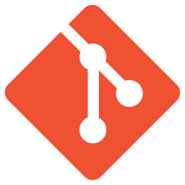



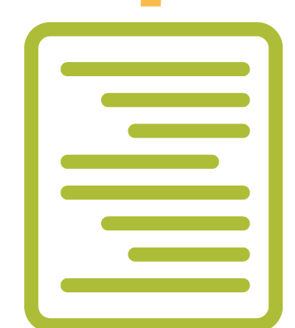

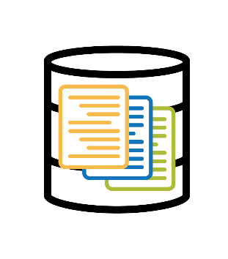




The right way to build software
Branch
Develop
Pull-request
Peer Review
Build
Approved
Succeeded
Store Build Artifacts
Deploy
Test
Use
Passed
Depending on Environment: Integration Tests, QA Tests, Build Verification, Deployment Verification, User Acceptance Testing, Customer Acceptance Testing.
Notes:
What is VC – Virtual Container (k8, Docker)
Stuart –
Make feature branch
Develop in feature branch (testing & commit as you go)
When branch ready for delivery, do a pull-request
Team peer reviews pull-request and if approved, code is pulled into development branch which kicks of a CI build
CI build artifacts are written to storage as a release
Release is automatically deployed to development environment
On demand, code is promoted to each of the subsequent environments (QA, UAT, etc.)
Release to production is “hit the release button”.
Code gets compiled once in each environment (versioning the release number) – make these non-events (make it boring)

Slide 7
Sidebar: What is in a good build?
Pull source
Compilation / Transpilation / Packing
Unit Tests
Static Code Analysis
Security Vulnerability Analysis
Automatic Semantic Versioning
Packaging / Storing of Artifacts

Slide 8
Common Objections
We don't have tools for this!
Really? Given the number of open source platforms, isn't more you have not tried?
It's too complicated!
Nope, not doing it is complicated, deployments that fail are complicated (and damaging)
It's weird
It's new, but then so was the wheel

Slide 9
End-To-End Automated Tests
Good for post-deployment verification
Especially configuration and networking
Provide a baseline of functionality to detect regression, and performance declines
Can be used as synthetic transactions to help monitor a system in production (all the big shops do this!)

Slide 10
Lemma: If you do not have automated integration and functional tests, you have no repeatable process to do post deployment verification that your system is ok.

Slide 11
Monitoring and Management
Hosting Environment
Log Aggregation and Analysis
Notification / Escalation Tool
Log Steams
Application
Application
Application
Queues
Events
Message
Events
Monitoring Platform
Ticketing/ALM
System
Database
Storage
Incidents
State

Slide 12
Common Objections
We don't have tools for this!
Really? Given the number of open source platforms, isn't more you have not tried?
It's too complicated!
Nope, no knowing what is going on with your applications and systems is complicated and dangerous.
So is hiding information from stakeholders
People won't do it
Convince them or fire them

Slide 13
Lemma: Sometimes the best way to solve a problem is to get rid of all the unhappy people.
We're not firing you, we're welcoming you to the economic opportunity pool.

Slide 14
Security
Better to know and be able to compensate then not know and flail

Slide 15

Application security
Apply tools to automatically identify security vulnerabilities in the code during the build process
Assess open source libraries continuously for known vulnerabilities to identify risks during development or build processes
Notes:
Tools: Checkmarx, Whitesource
Guidance for Trainer:
We want to check for security vulnerabilities. Ask: How many of you have these concerns? Do you usually check for these mostly in production or non-production environment?
We need to partner with info-sec, in order to try to bring them into the fold and collaborate more tightly.

Slide 16
Observations
Security concerns are backlog items just like any other requirement
The combined stakeholders of the business and IT get to assess the severity and decide what to do and when
Developers have a duty to formally report security concerns and poor practices

Slide 17
Lemma: Non-Functional Requirements, like Quality and Security, can't be added as an after thought.
Pixie dust? Seriously?

Slide 18
M+M Concern Checklist
The application can be built, deployed, and configured automatically and reliably
The process can be applied to any new environment with trivial effort
Security and performance testing is done at all levels and are treated as 1st class defects and incidents
HA and DR are improved

Slide 19
Lemma: If you can't test your disaster recovery or high-availability w/o disrupting the users or the business you don't actually have any DR/HA
Umm, it was "on" last time we looked…

Slide 20
Runbooks
A runbook is a central KB of knowledge about how to build, deploy, configure and troubleshoot an app.
Tooling is irrelevant, currency (e.g. it's relevant), and accessibility to all stakeholders are what counts
The easier it is to keep updated, the more likely it will be helpful
The best way to do that is to automate the runbooks so they actually produce environments.

Slide 21
Next: Migration Approaches and Checklist

Slide 22


Stuart Williams
Cloud/DevOps Practice Lead + National Markets Consultant
Magenic Technologies Inc.
Email: stuartw@magenic.com
Blog: http://blitzkriegsoftware.net/Blog
LinkedIn: http://lnkd.in/P35kVT
GitHub: https://github.com/BlitzkriegSoftware/MAL2018
YouTube: https://www.youtube.com/channel/UCO88zFRJMTrAZZbYzhvAlMg

